Slide 1
DEADLOCK
Satyanarayan Sahu

Slide 2
What is deadlock???
A deadlock is a condition where two or more transactions are waiting indefinitely for one another to give up locks.
Deadlock is said to be one of the most feared complications in DBMS as no task ever gets finished and is in waiting state forever.

Slide 3
Example of Deadlock
In the student table, transaction T1 holds a lock on some rows and needs to update some rows in the grade table. Simultaneously, transaction T2 holds locks on some rows in the grade table and needs to update the rows in the Student table held by Transaction T1.

Slide 4
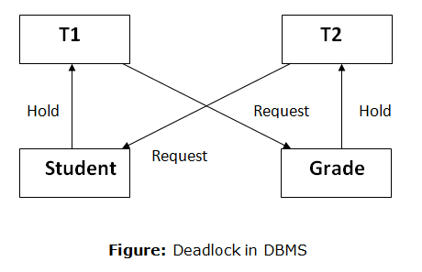
Example of Deadlock

Slide 5
Deadlock Avoidance
When a database is stuck in a deadlock state, then it is better to avoid the database rather than aborting or restating the database. This is a waste of time and resource.
Deadlock avoidance mechanism is used to detect any deadlock situation in advance.
A method like "wait for graph" is used for detecting the deadlock situation but this method is suitable only for the smaller database. For the larger database, deadlock prevention method can be used.

Slide 6
Deadlock Detection
In a database, when a transaction waits indefinitely to obtain a lock, then the DBMS should detect whether the transaction is involved in a deadlock or not.
The lock manager maintains a Wait for the graph to detect the deadlock cycle in the database.

Slide 7
Deadlock Detection
Wait for Graph
This is the suitable method for deadlock detection. In this method, a graph is created based on the transaction and their lock. If the created graph has a cycle or closed loop, then there is a deadlock.
The wait for the graph is maintained by the system for every transaction which is waiting for some data held by the others. The system keeps checking the graph if there is any cycle in the graph.

Slide 8
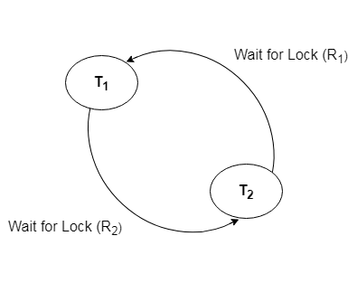
Deadlock Detection
Wait for graph

Slide 9
Deadlock Prevention
Deadlock prevention method is suitable for a large database. If the resources are allocated in such a way that deadlock never occurs, then the deadlock can be prevented.
The Database management system analyzes the operations of the transaction whether they can create a deadlock situation or not. If they do, then the DBMS never allowed that transaction to be executed.

Slide 10
Wait-Die Scheme
In this scheme, if a transaction requests for a resource which is already held with a conflicting lock by another transaction then the DBMS simply checks the timestamp of both transactions. It allows the older transaction to wait until the resource is available for execution.

Slide 11
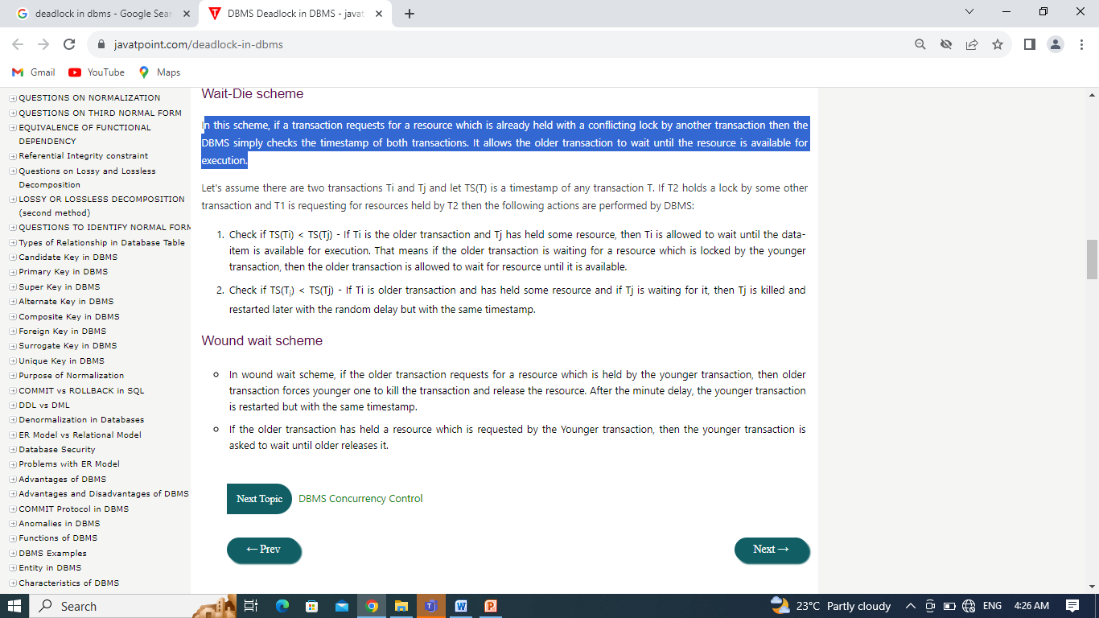
Wait-Die Scheme

Slide 12
Wound wait scheme
In wound wait scheme, if the older transaction requests for a resource which is held by the younger transaction, then older transaction forces younger one to kill the transaction and release the resource. After the minute delay, the younger transaction is restarted but with the same timestamp.
If the older transaction has held a resource which is requested by the Younger transaction, then the younger transaction is asked to wait until older releases it.

Slide 13
Thank You

